Slide 1

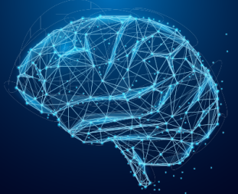
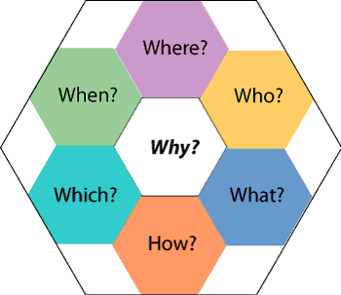


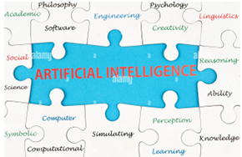
Core Questions of
(Artificial) Intelligence
Dr. Talha Waheed
Department of Computer Science, UET, Lahore

Slide 2
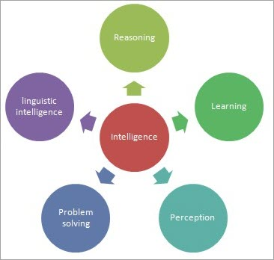
What is Intelligence? What is Artificial Intelligence?
(and what they are not)?
Intelligence – A broad definition
A property of mind that involves
related abilities, such as:
to reason,
to learn,
to perceive,
to solve problems,
to use language,
to think abstractly,
to plan,
to grasp ideas, etc.
Artificial Intelligence [Marvin Minsky, MIT AI Lab]
“the science of making machines do things that would require intelligence if done by men”

Slide 3

Activity
Write an interesting question that comes to your mind
about human intelligence?

Slide 4
Few Core Questions About Human Intelligence
Is it a single faculty or a collection of distinct and unrelated abilities? (Single vs Multiple Intelligence)
Is intelligence measurable? Is there a unit for Intelligence? (IQ, EQ, Machine IQ)
Can we infer it from observable behaviour (behavioral psychology) or does it require evidence of internal mechanism (neuroscience)?
To what extent is intelligence learned or is it have a priori existence? (Nature vs. nurture)
With modern neuroscience techniques, can we locate and measure intelligence within the brain?
What happens in brain when learning occurs? (it strengthen neural pathways)
How is knowledge represented in the nerves of a human (single neuron vs network, or network of networks) ? Is it helpful in designing intelligent machines?

Slide 5
Few More Questions About Human Intelligence
What is the relationship of following concepts with Intelligence? How can they be developed?
  Thinking
  Learning
  Perception
  Reasoning
  Planning
  Brain and Mind
  Information vs Knowledge
  Creativity (is it a chaotic process?)
  Intuition vs self-awareness (consciousness)

Slide 6
Consciousness is Theory of Everything?
  Human (Self Consciousness, Spatio-Temporal Consciousness, Divine Consciousness)
  Animals (is dog self-aware, animal rights)
  Plants (watch YouTube videos on plant consciousness)
  Minerals, Material (What if water droplets from 2 different sources are combined ?)
  is there a categorical difference in their consciousness or it is a continuum on same degree?
  Machine Consciousness
  Machine (Robot vs. chatbot / What should be conscious ? Hardware or Software?)
    Is computer knows and feels what song it is playing?
    Artificial Consciousness/ Artificial Emotions/ Sentiment Analysis & Generation

Slide 7
Few Core Questions About Artificial Intelligence
Is it necessary to imitate human intelligence (Computational Intelligence)?
Or a strict engineering approach is sufficient? (Artificial Intelligence)
Is it (ever) possible to achieve (human) intelligence on a machine?
And up to what extent? (Limits of AI)
Or does an intelligent entity require the richness of sensation and experience that is found in biological/molecular systems? (Situatedness)
What does Fault-tolerant systems, self-repairing software depicts about AI (auto-updation of windows)

Slide 8
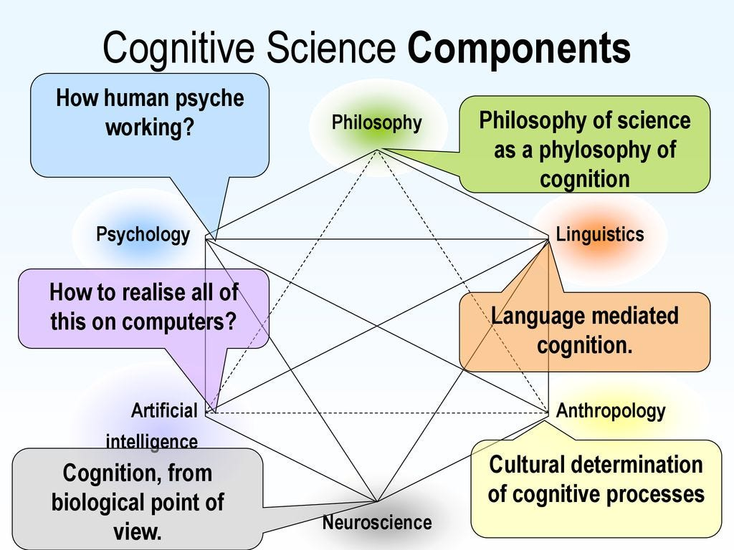
To Solve this Puzzle of Intelligence We Need
To Understand Human Intelligence
(Broad - Computational Intelligence/Cognitive Sc)
AI is kind of a lab (medium) for finding answers about (human) intelligence:
(theories tested by computer programs and
verified through their execution on a machine.)
To Design Intelligent Systems
(Narrow - Artificial Intelligence)
Branch of computer science to automate any intelligent behaviour.
Typically deals with subjects like data structure, algorithms, programming languages, ML/DL

